Slide 1

JAIN COLLEGE OF ENGINEERING AND RESEARCH
Department of computer science & engineering
DETECTION OF MANIPALATED MULTIMEDIA IN DIGITAL FORENSICS USING MACHINE LEARNING
Under the Guidance of
Dr. ANAND GUDNAVAR
Project Team Members
1. Mohanish Nagzarkar 2JR19CS042
2. Preetam Anvekar 2JR19CS052
3. Tejashwini Pallakke 2JR19CS088
4. Shraddha Sambrekar 2JR20CS421

Slide 2
Contents
INTRODUCTION
LITERATURE SURVEY
SOFTWARE AND HARDWARE REQUIREMENTS
METHODOLOGY
SCREENSHOTS
CONCLUSION
REFERENCES

Slide 3
INTRODUCTION
With the rise of digital media and editing tools, the manipulation of multimedia, including images, audio, and video, has become increasingly prevalent.
This manipulation can range from simple modifications, such as cropping or adjusting brightness, to more sophisticated techniques, such as deepfake generation or content replacement
This manipulation has serious implications for the authenticity and trustworthiness of multimedia content, as it can be used to spread misinformation, manipulate public opinion, and even cause harm.

Slide 4
INTRODUCTION
Image forensics: This technique involves analyzing the characteristics of the image itself, such as the presence of duplicate or tampered areas, inconsistencies in lighting, and changes in color saturation.
Audio forensics: This technique involves analyzing the audio file itself, such as the presence of unusual background noise, inconsistencies in pitch and tempo, and artifacts caused by editing.
Video forensics: This technique involves analyzing the video file itself, such as the presence of splices, cut and paste operations, and inconsistencies in lighting and texture.

Slide 5
LITERATURE SURVEY
[1] Ravi Shankar, Akshat Srivastava, Gurunath Gupta, Rohini Jadhav, 5Umesh Thorate, “Fake Image Detection Using Machine Learning”, 5 May 2021
This paper proposed image manipulation detection techniques using error level analysis. Through intensive experiments, the proposed model was analyzed and showed that at least 90 % accuracy was achieved.

Slide 6
LITERATURE SURVEY
[2] R.L.M.A.P.C. Wijethunga,D.M.K. Matheesha , Abdullah Al Noman, K.H.V.T.A. De Silva, Muditha Tissera,Lakmal Rupasinghe “ Deepfake Audio Detection: A Deep Learning Based Solution for Group Conversations”,May 16,2021
This paper proposed some of the best available datasets prepared by researchers which were freely available for public use. This paper has included audio signal processing techniques, speaker diarization approaches, and synthetic speech detection mechanisms.

Slide 7
LITERATURE SURVEY
[3] David Guera and Edward J. Delp , “Deepfake Video Detection Using Recurrent Neural Networks”, 24 June 2020.
In this paper presented a temporal-aware system to automatically detect deepfake videos. Our experimental results using a large collection of manipulated videos have shown that using a simple convolutional LSTM structure we can accurately predict if a video has been subject to manipulation or not with as few as 2 seconds of video data.

Slide 8
LITERATURE SURVEY
[4] Huy H. Nguyen, Junichi Yamagishi, and Isao Echizen, “Use of a Capsule Network to Detect Fake Image and Videos”, 29 October 2019.
This paper introduce a capsule network that can detect various kinds of attacks. It uses many fewer parameters than traditional convolutional neural networks with similar performance.

Slide 9
LITERATURE SURVEY
[5] Asad Malik, Minoru Kuribayashi, Sani M. Abdullahi, and Ahmad Neyaz Khan, “Deepfake Detection for Human Face Images and Videos”, 11 February 2022.
This paper presents Deepfake detection methods in face images and videos on the basis of their results, performance, methodology used and detection type.

Slide 10
SOFTWARE AND HARDWARE REQUIREMENTS
HARDWARE REQUIREMENTS
Laptop/ PC
Processor: Intel Core or AMD with 64 bits Processor
Minimum 8 GB RAM (As deep learning required large module)

Slide 11
SOFTWARE AND HARDWARE REQUIREMENTS
SOFTWARE REQUIREMENTS
Operating System: Windows, Linux (As they are convenient to use)
Python 3.8 and above (As previous version is not in use of library)
IDE
▪ Jupyter Notebook (features are suited for data analysis)
▪ VScode (As it supports all the languages, and easy to develop)

Slide 12
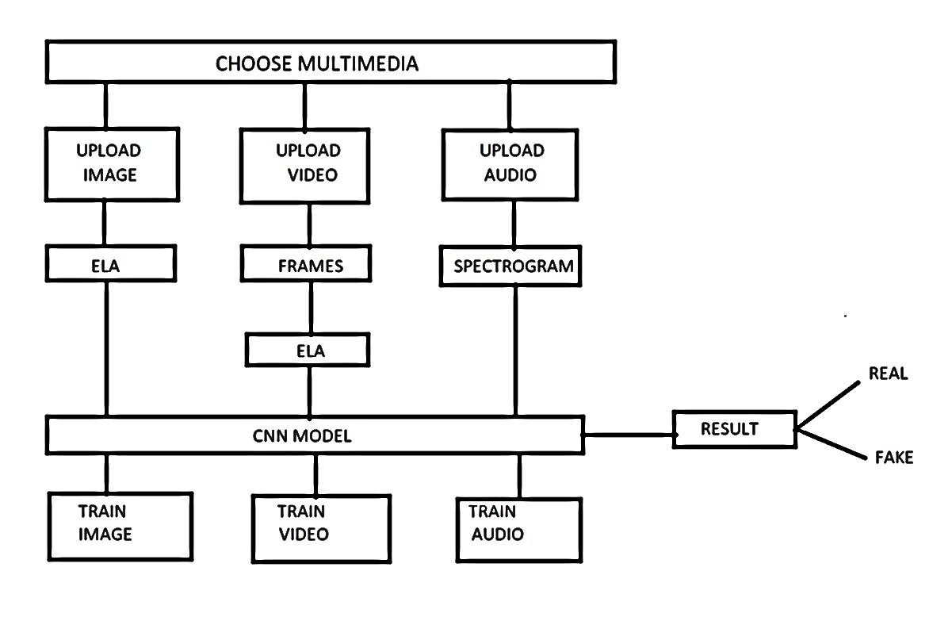
Methodology
ELA- Error Level Analysis
MFCC- Mel-Frequency Cepstral Coefficients
CNN- Convolutional Neural Network
MFCC

Slide 13
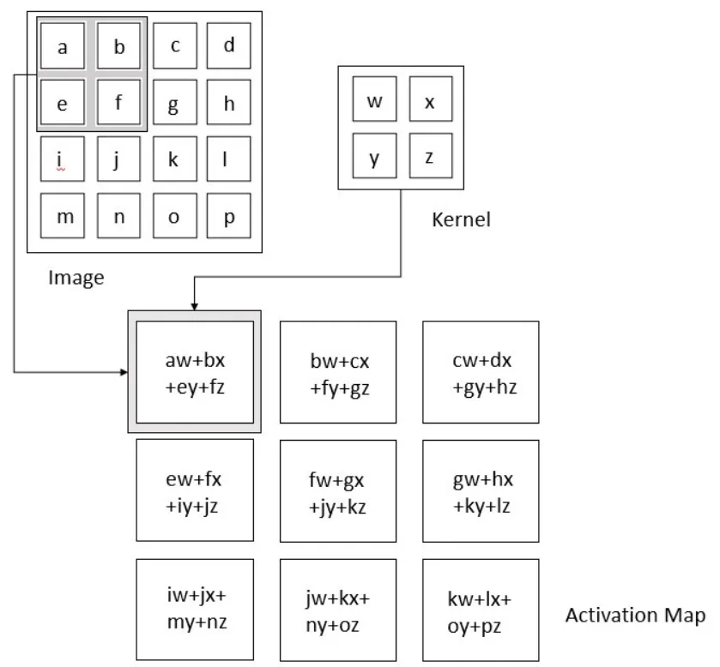
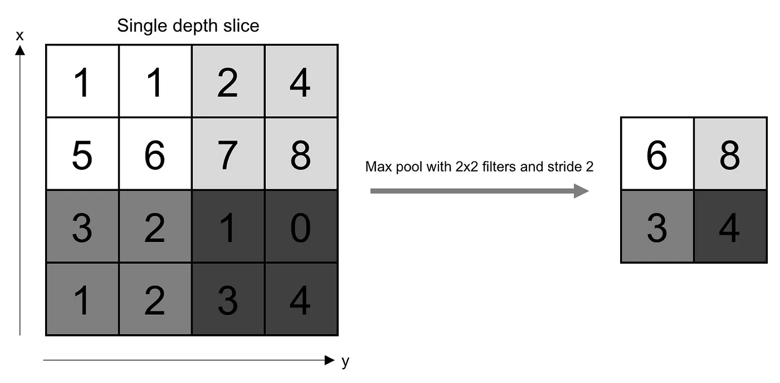
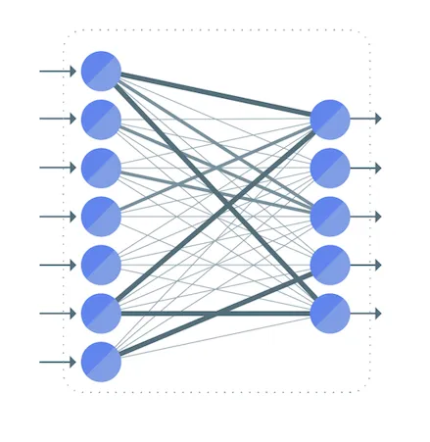
CNN MODEL

Slide 14
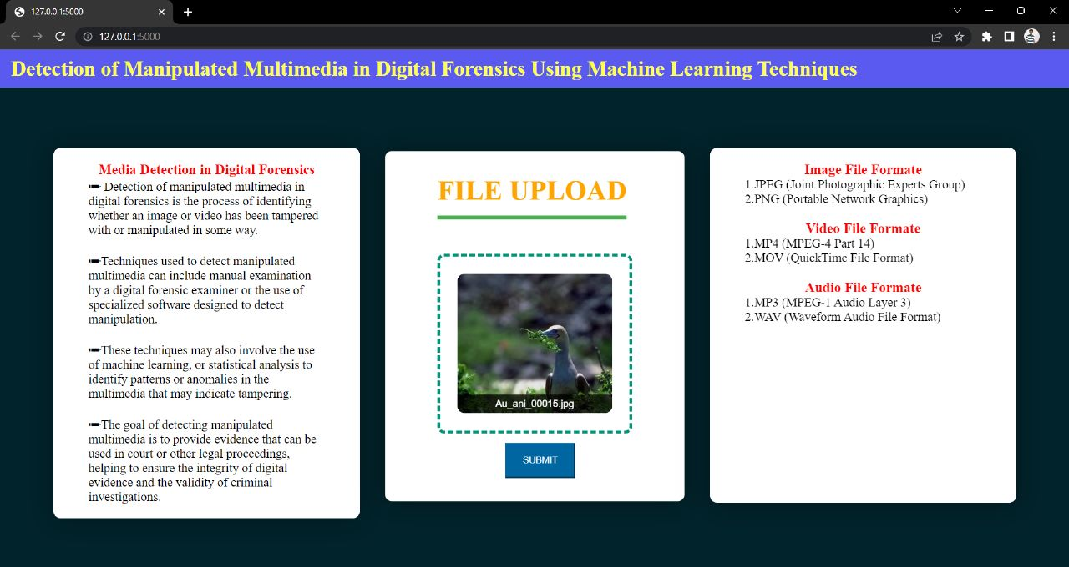
SCREENSHOTS

Slide 15
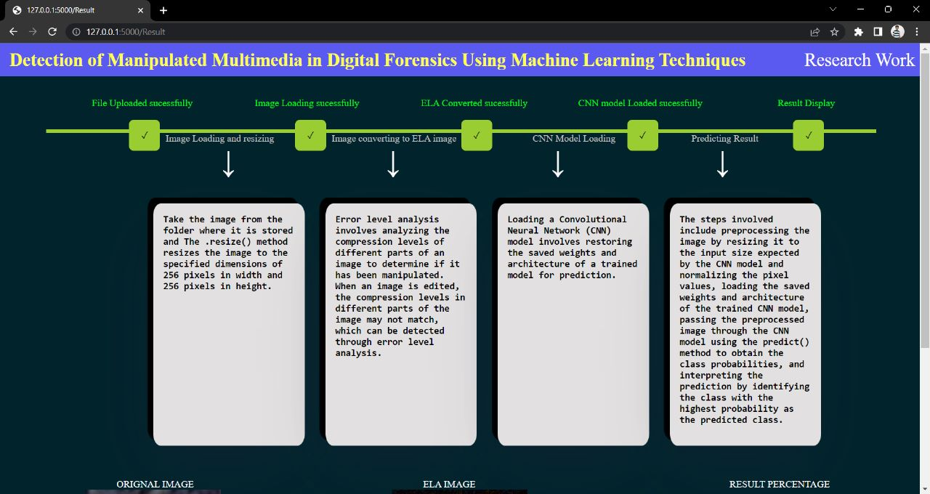
IMAGE DETECTION INTERFACE

Slide 16
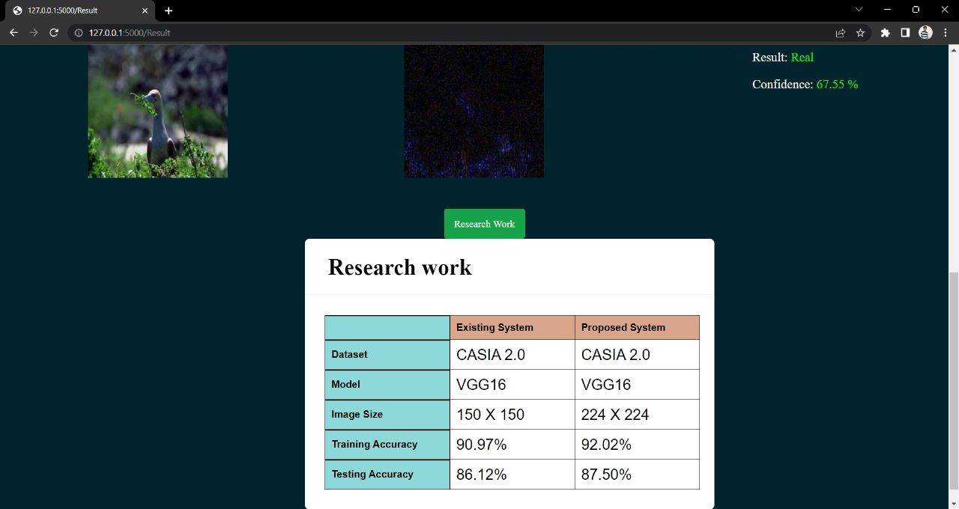
IMAGE DETECTION INTERFACE

Slide 17
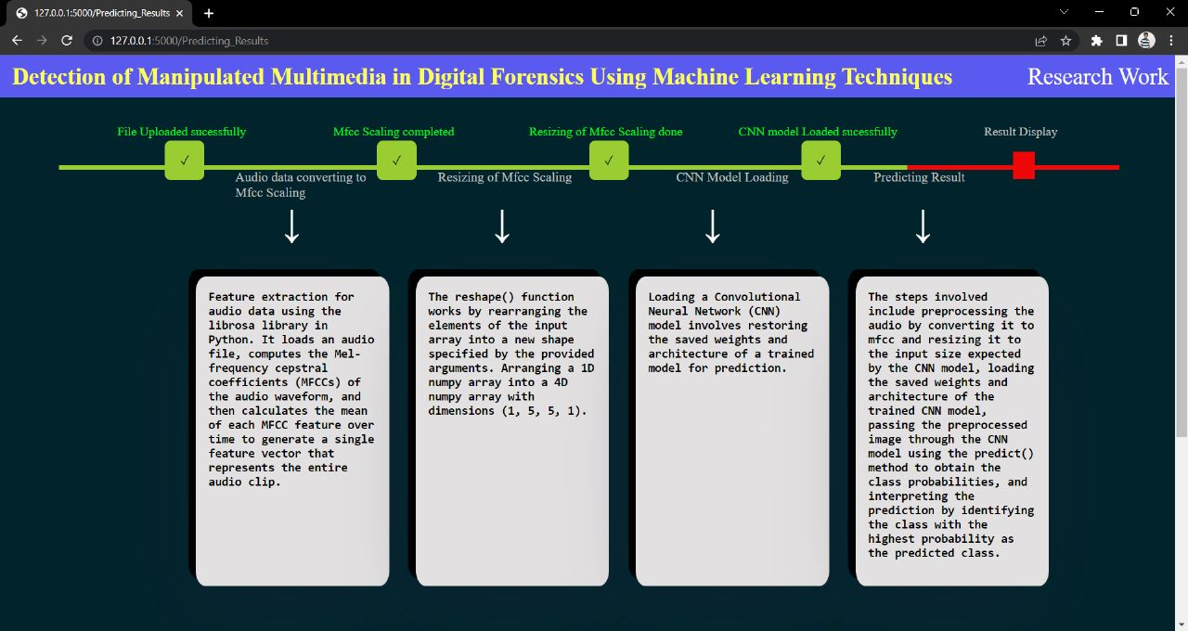
AUDIo DETECTION INTERFACE

Slide 18
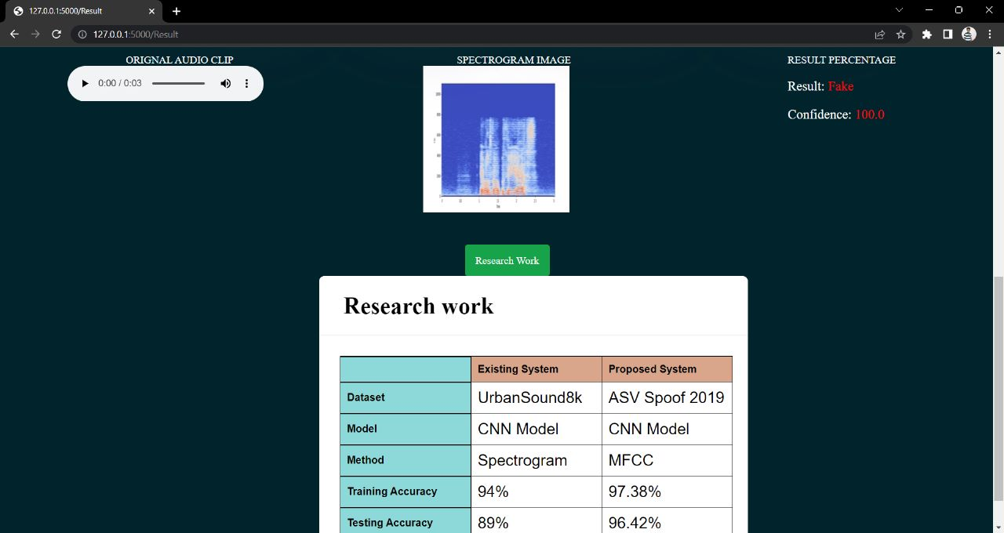
AUDIo DETECTION INTERFACE

Slide 19
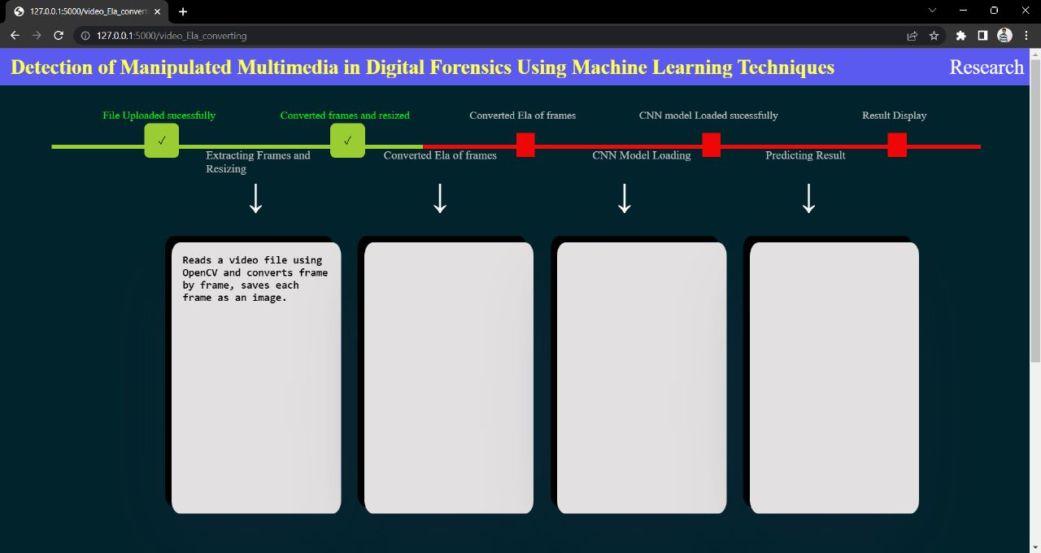
Video DETECTION INTERFACE

Slide 20
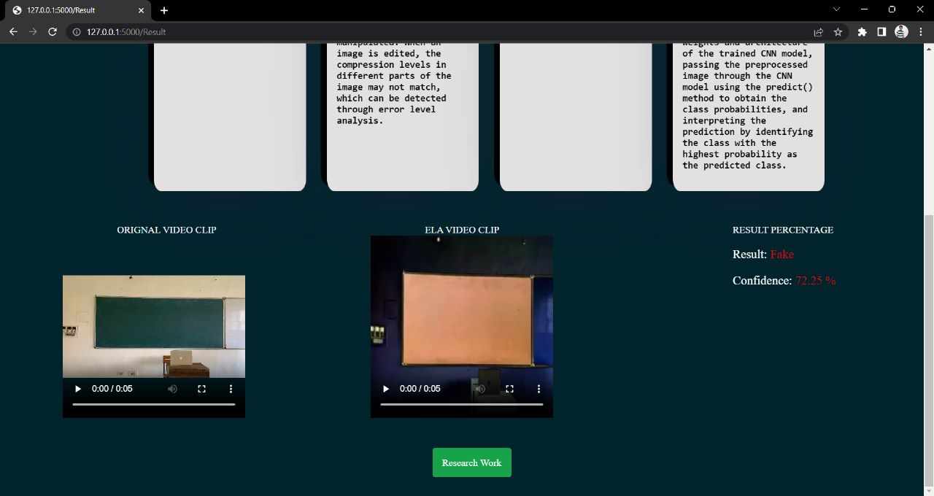
Video DETECTION INTERFACE

Slide 21
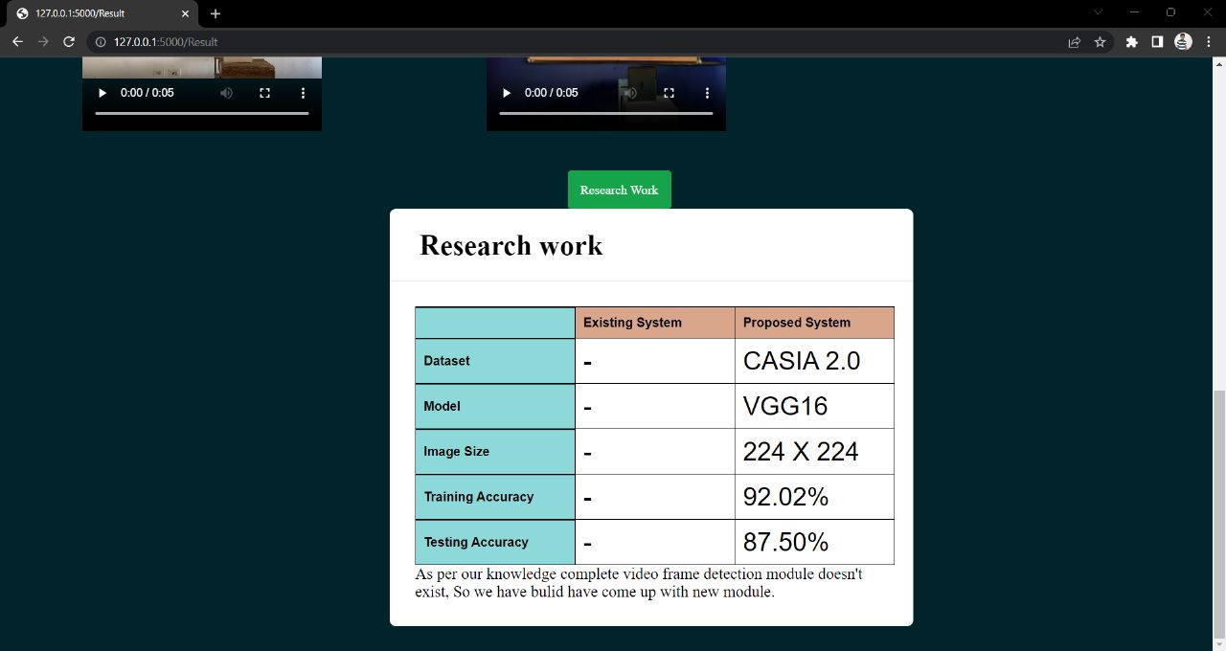
Video DETECTION INTERFACE

Slide 22
Results Summary
Upload media (Image, Audio,Video), after uploading it redirect to specific detection page based on file format.
Image is converted to ELA and predict the result.
Audio is converted to numpy array based on time and frequency (MFCC function) and predict result
Video is converted to ela frames and predict result.
If confidence is ranging between 45 to 55 then result is “It might be Fake” because model is not able to predict it is real for fake media.

Slide 23
CONCLUSION
Probably one of the most exciting fields in the computing world today is Cyber Forensics.
Tampered multimedia content is being increasingly used in a broad range of cybercrime activities.
In existing system Multimedia was implemented separately.
To overcome this problem we are implementing all Multimedia in a single system.
Detection of the multimedia whether that is genuine or fake.
Notes:
ide

Slide 24
FUTURE WORK
Finding Manipulated Area (Highlighting the location in media).
Enhance User Interface Design (Make Dynamic website).
Extend Fake News Detection.

Slide 25
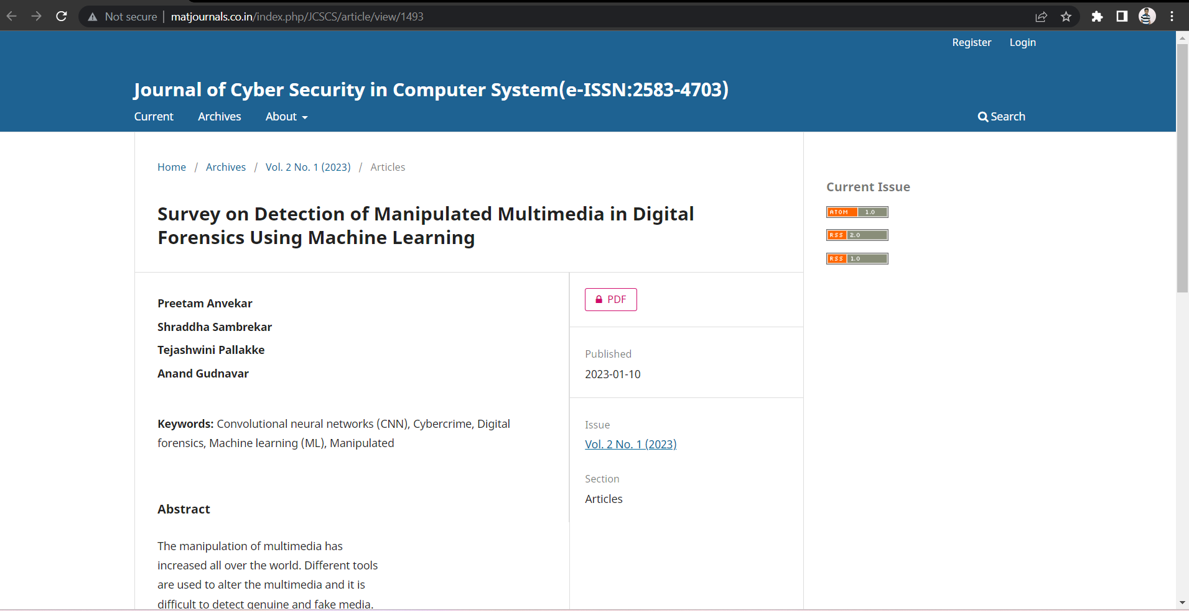
Published Survey Paper
Journal Name: Journal of Cyber Security in Computer Science
Published on 10-01-2023
Issue: Volume-2, Issue-1
DOI: https://doi.org/10.46610/JCSCS.2023.v02i01.002

Slide 26
REFERENCES
[1] Ravi Shankar, Akshat Srivastava, Gurunath Gupta, Rohini Jadhav, 5Umesh Thorate, “Fake Image Detection Using Machine Learning”, 5 May 2021.
[2] R.L.M.A.P.C. Wijethunga,D.M.K. Matheesha , Abdullah Al Noman, K.H.V.T.A. De Silva, Muditha Tissera,Lakmal Rupasinghe “ Deepfake Audio Detection: A Deep Learning Based Solution for Group Conversations”,May 16,2021.
[3] David Guera and Edward J. Delp ,Video and Image Processing Laboratory (VIPER), Purdue University, “Deepfake Video Detection Using Recurrent Neural Networks”, 21 June 2020.
[4] Huy H. Nguyen, Junichi Yamagishi, and Isao Echizen, “Use of a Capsule Network to Detect Fake Image and Videos”, 29 October 2019.
[5] Asad Malik, Minoru Kuribayashi, Sani M. Abdullahi, and Ahmad Neyaz Khan, “DeepFake Detection for Human Face Images and Videos”, 11 February 2022.

Slide 27
THANK YOU

